Slide 1
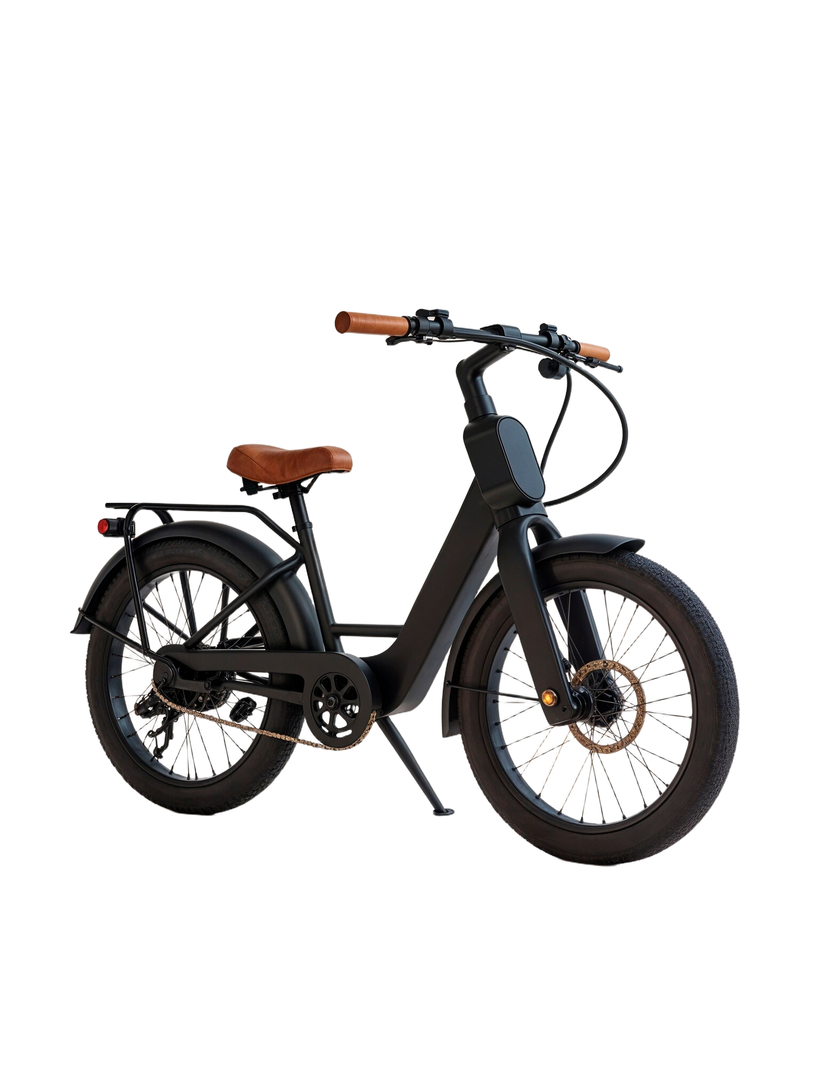
Electric Bicycle
Elektron Cycles
Hulikkal Electro India Pvt Ltd
Ampere Vehicles
BSA Motors
Electrotherm
Spero
Hero Electric
Pure EV

Slide 2
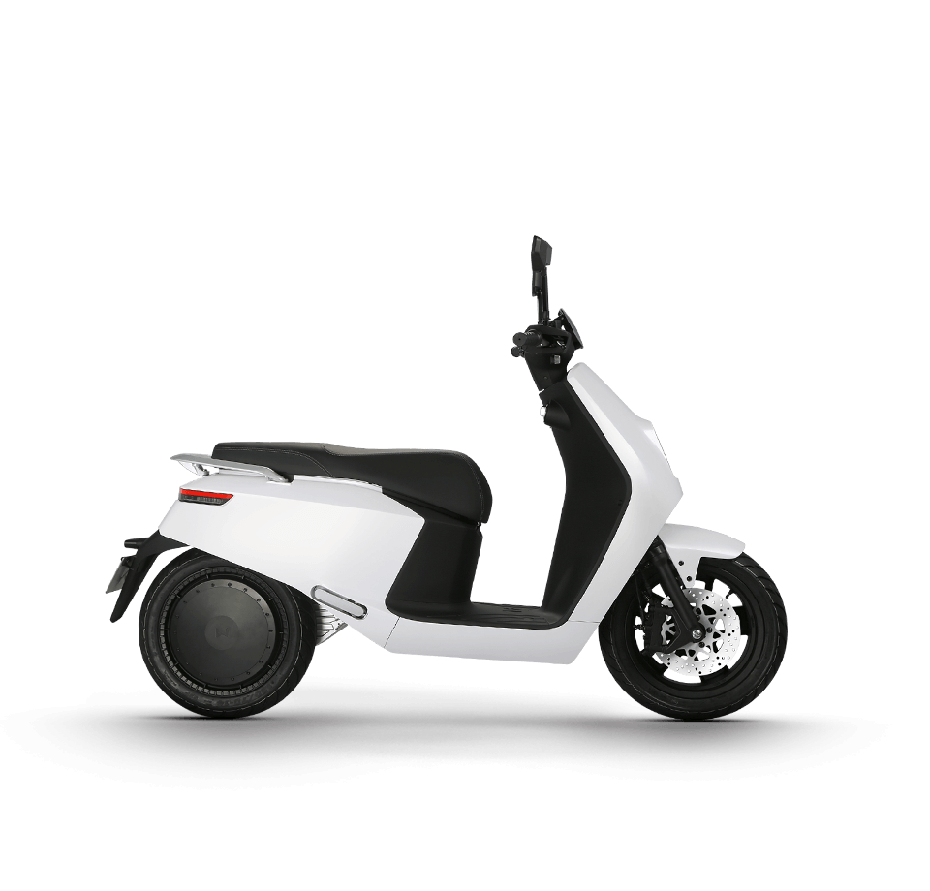
Electric Motor Cycle& Scooters
Earth Energy EV
Twenty-Two Motors
Ampere vehicles
AVERA New and Renewable Energy Moto Corp Tech Pvt Ltd
Okinawa Autotech Pvt. Ltd
Ather Energy Pvt Ltd
Heroelectric (Hero Motocorp)
Yo-Bykes (ELECTROTHERM (INDIA) LTD.)
Lohia Auto Industries
Palatino (Xxplore Automotive Pvt Ltd.)
Tork Motors

Slide 3
Electric Motor Cycle& Scooters
EMflux motors
Ultraviolette Automotive
Tunwal E Vehicles private limited
BSA motors
BPG
EKO
OK PLAY
Rexnamo
Thunder wind
Revolt Motors

Slide 4
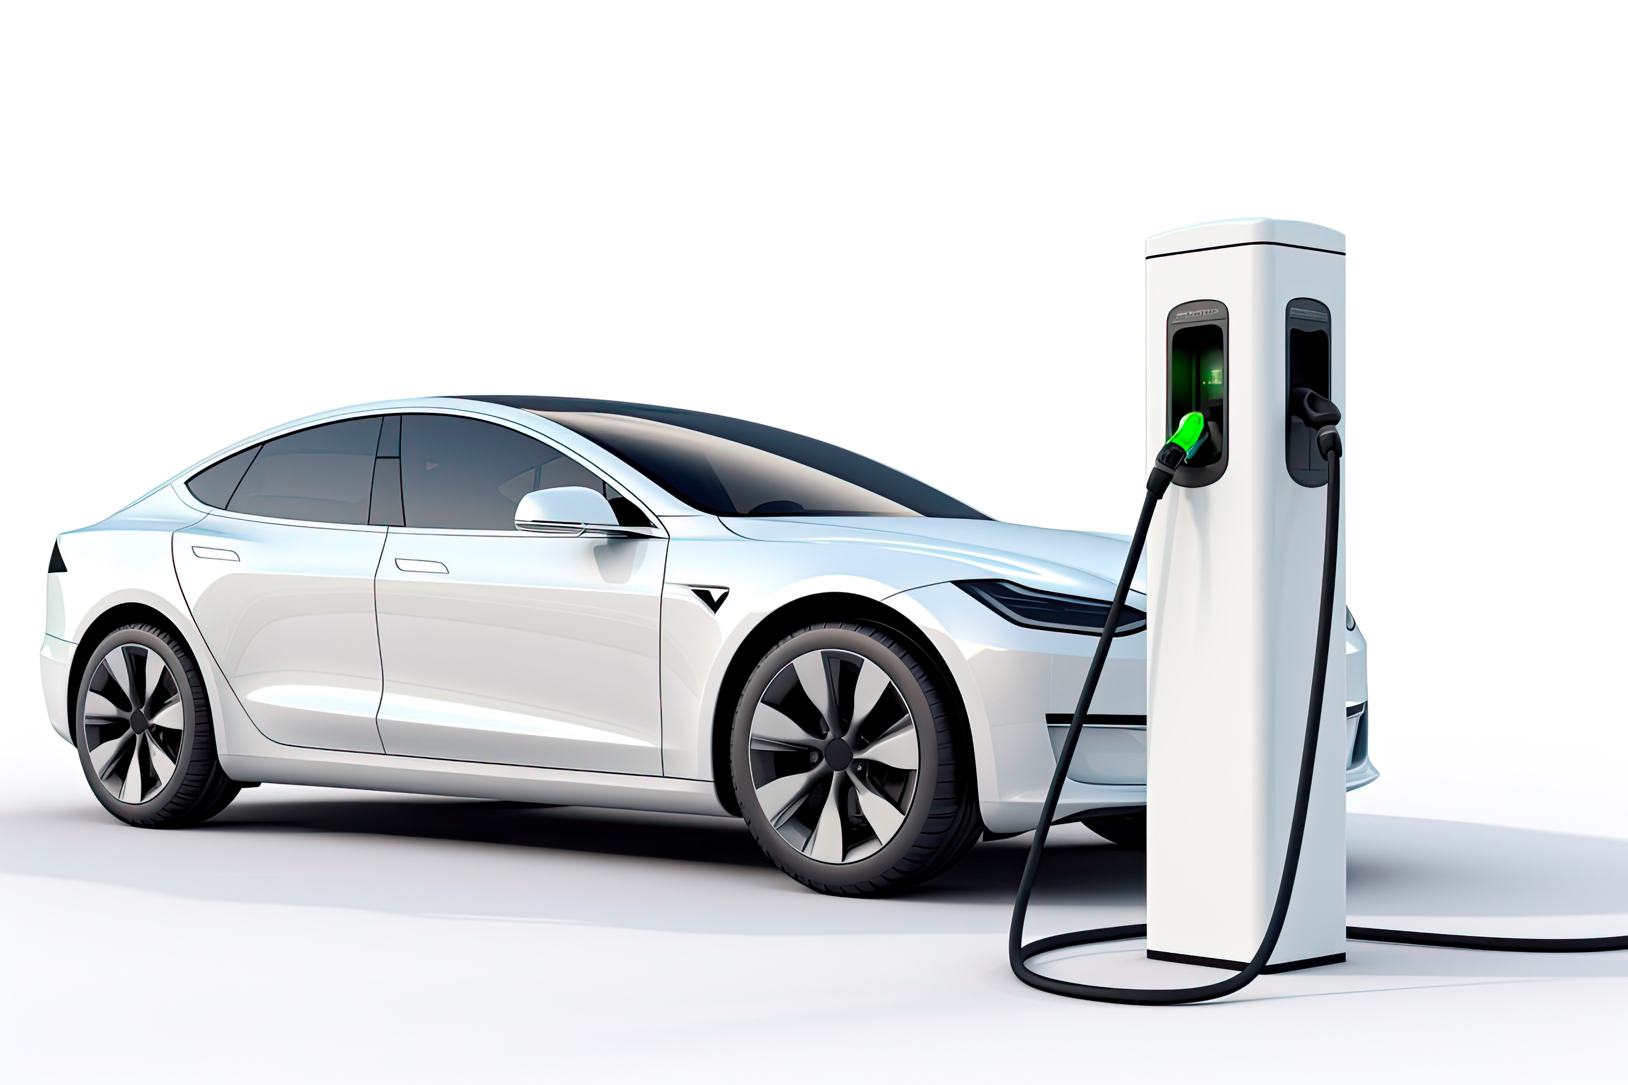
Electric Cars (Complete Electric)
Hyundai Kona Electric
Mahindra e-Verito
Mahindra e20
MG ZS EV
Tata Tigor EV
Tata Nexon EV

Slide 5
Electric Cars (Hybrid)
Toyota Prius
Honda Accord Hybrid
Toyota Camry
MG Hector
Suzuki Ciaz
Suzuki Swift
Suzuki Ertiga
Mahindra Scorpio Intelli hybrid
Toyota Camry Hybrid
BMW i8

Slide 6
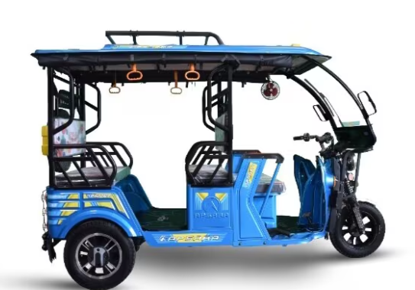
Electric Rickshaws
CEEON INDIA
Adapt Motors Pvt Ltd.
Volta Motors
Kinetic Green
Gayam Motor Works
REEP Industries - REEP Motors
Mahindra electric
Ampere Vehicles
Go Green BOV
OK play
Atul Auto Ltd.

Slide 7
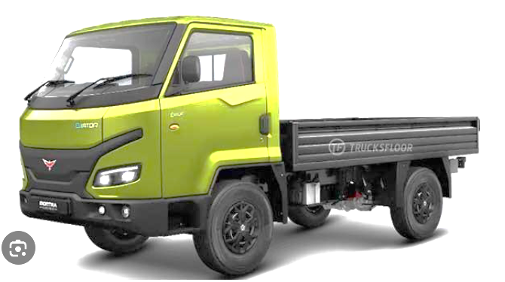
Mini Electric Pick-up Trucks
Mahindra
Tata Motors Ace Electric
Ashok Leyland Dost Electric Pick-Up Truck
ECOYAN
Croyance Automotive, ELECTRO

Slide 8
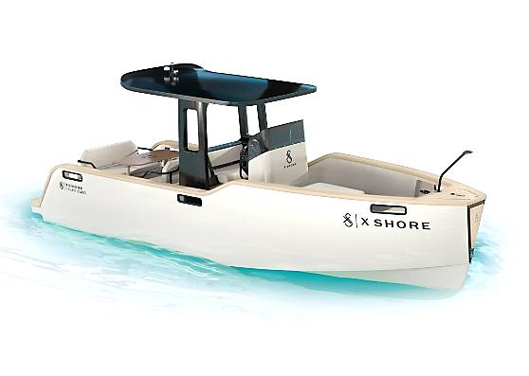
Electric Boat
NavAlt -Aditya

Slide 9
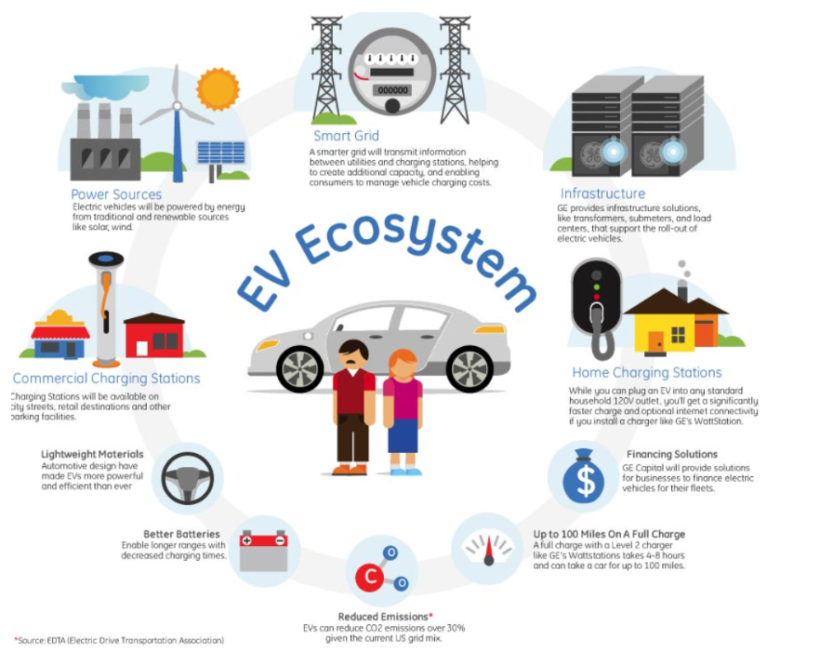
EV Ecosystem

Slide 10
EV Business Propositions
Servicing Garage
Charging Station
Painting & Spraying workshop
Charging Station Management
Electrical Workshop for EVs
Home Charging Station Setup Service
Charging Station Setup Training Service
EVRental Service
Spare Parts Manufacturing
EV Manufacturing
EVRetrofitting
Spare Parts Selling
EV Kits Service
EV Battery Shop
Electric Car Washing
Battery Swapping
Battery Leasing
Mobile EV Repair Services
Franchising/Reselling
Portable Charging Station
Solar Charging Station Installation Centre
Online Shop for Electric Spare Parts
Online Shop for EV Reselling
Battery Scrapping
Last mile connectivity
Finance Services
Insurance Services
EV Skill Development

Slide 11
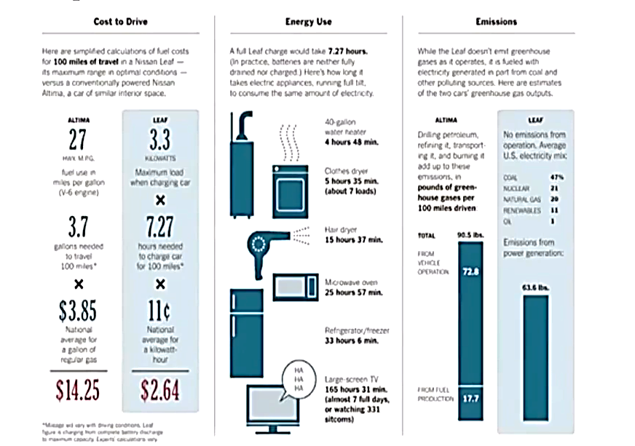
Comparison of an EV with CV

